Slide 1
Hendry Cavendish (1731-1810)
England specialist in Chemistry and Physics
he was the first scientist who studied about the density of gas.
he was born on 10th October 1731 in Nice to a noble family
his father Lord Charles Cavendish was a member of the Royal Society of London.
He received his school education from Hackney School in Nice.
In 1749 he went to England and studied at Peter’s College, Cambridge but he discontinued his degree course.

Slide 2
In 1760 he elected as fellow of the Royal Society of London.
He spent several years to know ‘Inflammable Air’(Hydrogen) and ‘Fixed Air’(Carbon-di-oxide)
He published his experiments on ‘Factitious Airs’ published in the Journal of Royal Society in 1766. he earned the Royal Society's Copley Medal for this paper.
His another paper entitle ‘Experiments in Air” published in 1784.
In 1798 he published ‘Experiments to Determine the Destiny of the Earth’

Slide 3
Nature of Hydrogen
Colourless
Highly flammable
light in weight
Hydrogen is used in Hydrogen Peroxide which is used as an antiseptic

Slide 4
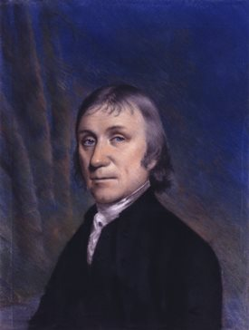
Josephy Priestley 1733-1804
Contemporary scientist of Hendry Cavendish
He was specialised in the field of Chemistry and Physics
he lost his mother when he was in six years old.
he earned his school education from Parish school in Bristol
he learned Greek, Hebrew and other classical languages
in 1764 he got Doctor of Law

Slide 5
He had friendship with Benjamin Franklin
with the support of Franklin Priestly wrote the book 'History of Electricity' in 1767.
he discovered that only water and metal can conduct electricity.
he was tutor at Warrington in a college
in 1770 he concentrated on ' penumatic chemistry'
his main work 'Copley Medal' was presented in Royal Society of London.

Slide 6
Role of air
He was the first produced Oxygen on 1st August in 1774
He discovered oxygen(O2)
Oxygen also called as life-giving gas
He was born at Bristol in Yorkshire (England)

Slide 7
Invented Soda Water (infusion water with Carbon dioxide)
CO2 or Carbon di oxide is the most important ingredient of the soft drinks
it gives sour taste and it gives sound when bottle is opened.

